Slide 1
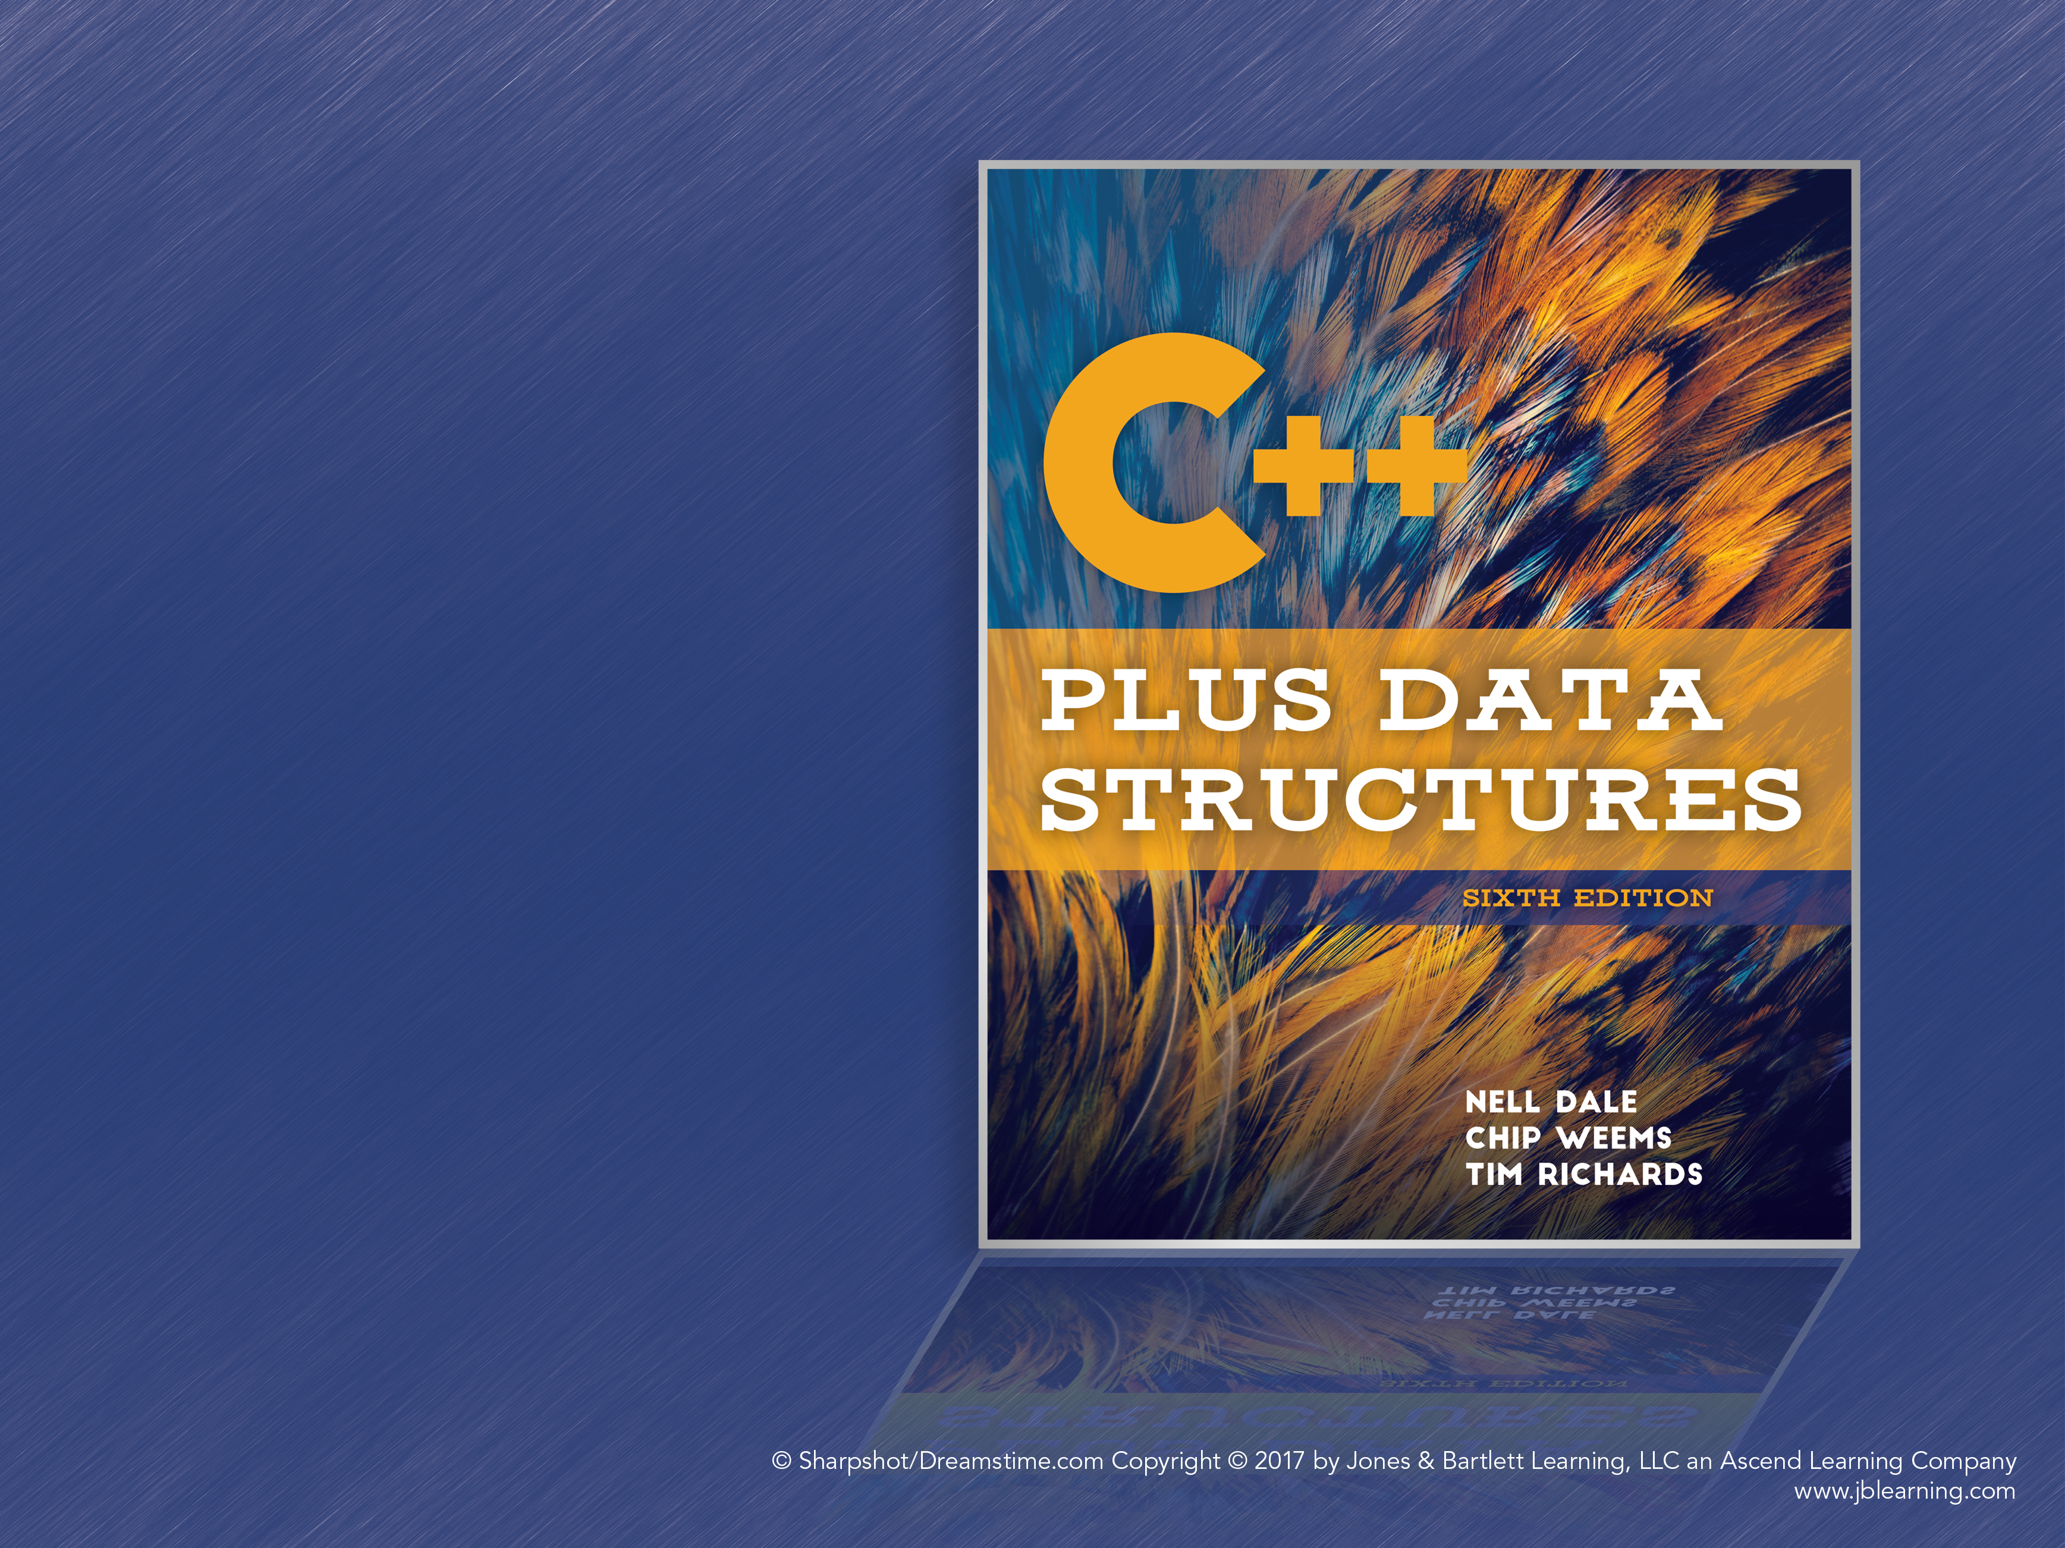
Chapter 6
Lists Plus
Notes:
1

Slide 2
C++ Templates
Generic Data Type: A type for which only the operators are defined; the ItemType used by our ADTs is generic
Template: A C++ feature by which the compiler generates multiple versions of a class by using parameterized types
Essentially allows “blanks” in the class definition that clients can fill in to customize the class
template<class ItemType>

Slide 3
Example: Stack ADT Template
template<class ItemType>
class StackType
{
public:
StackType();
bool IsEmpty() const;
bool IsFull() const;
void Push(ItemType item);
void Pop();
ItemType Top() const;
private:
int top;
ItemType items[MAX_ITEMS];
};

Slide 4
Example: Stack ADT Template (cont.)
Clients use the template like so:
StackType<int> intStack;
StackType<float> floatStack;
StackType<char> charStack;
The compiler will generate a specialized version of StackType for each variable.

Slide 5
Function Templates
Functions are turned into templates using the template keyword, just like classes
A template class’s methods must also be function templates if they use the type variable in the template
For example, Push has an ItemType parameter and must be made into a function template

Slide 6
Example: Push Template
template<class ItemType>
void StackType<ItemType>::Push(ItemType newItem)
{
if (IsFull())
throw FullStack();
top++;
items<top> = newItem;
}

Slide 7
Source Files and Templates
Usually, the class header (StackType.h) and member function definitions (StackType.cpp) are two separate files
This way, the class’s object code can be compiled independently of the client code
But with templates, the compiler must know the actual type parameter for the template, which appears in the client code

Slide 8
Source Files and Templates (cont.)
The general solution is to compile the client code and the class’s methods at once
Write class definition and method implementations in one file
Or use separate files, but #include the implementation at the end of the header
When the client #includes the header, the compiler will have access to all the code it needs

Slide 9
Circular Linked Lists
A linked list in which every node has a successor
The “last” element is succeeded by the “first” element
The class definition doesn’t change, but traversing the list is a little more complex

Slide 10
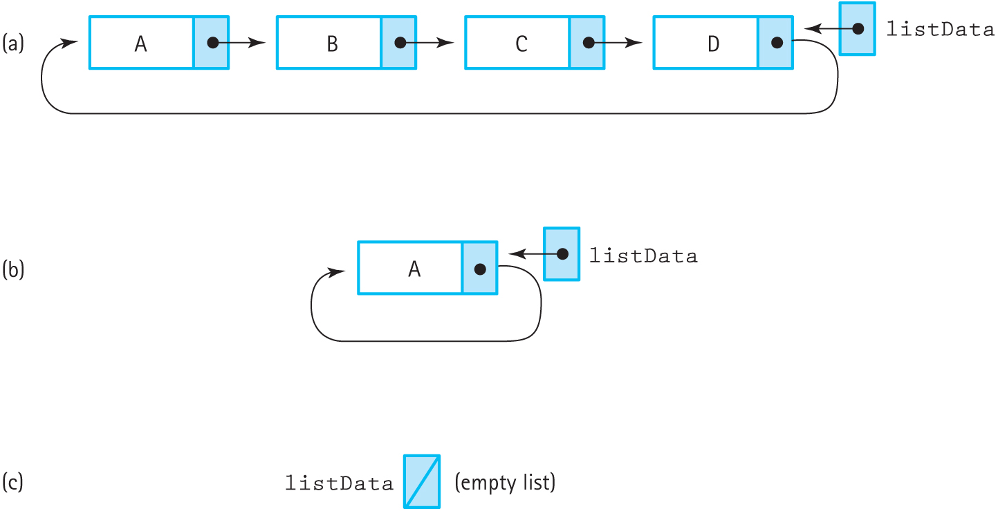
Circular Linked List (cont.)
Figure 6.2 Circular linked lists with the external pointer pointing to the rear element

Slide 11
Circular Linked List: Finding Items
GetItem, PutItem, and DeleteItem all search the list, create a helper function called FindItem
Search stops when:
A key greater than or equal to the target item’s key is found
It encounters the first item in the list again (this is the “end” of the list)
Returns location, previous location, and a flag
- If the flag is true, location points to the found item; if false, it points to the item’s successor

Slide 12
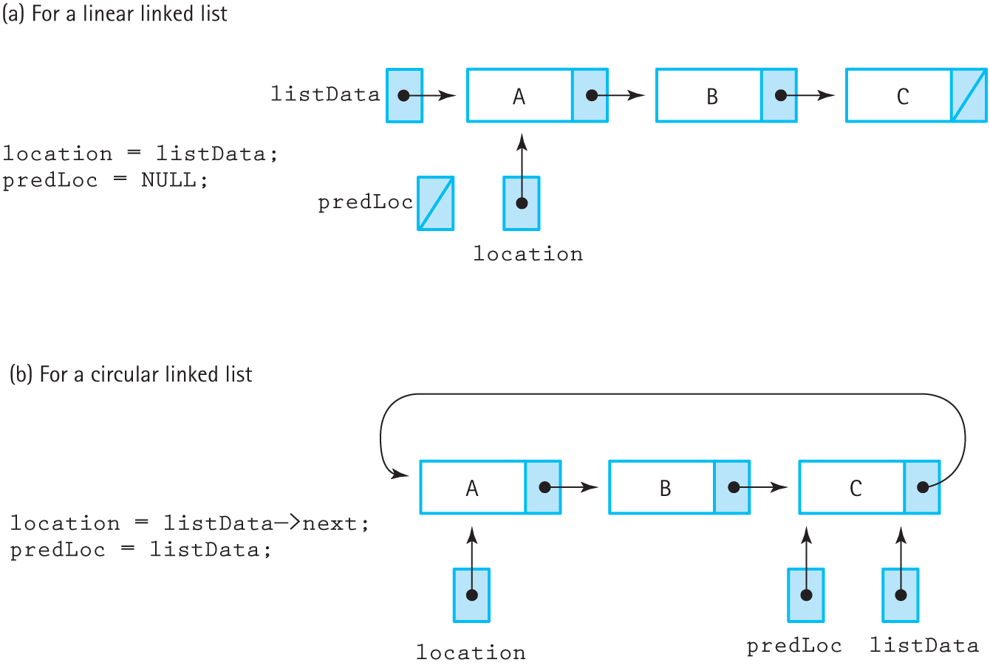
Circular Linked List: Finding Items (cont.)
Figure 6.3 Circular linked lists with the external pointer pointing to the rear element

Slide 13
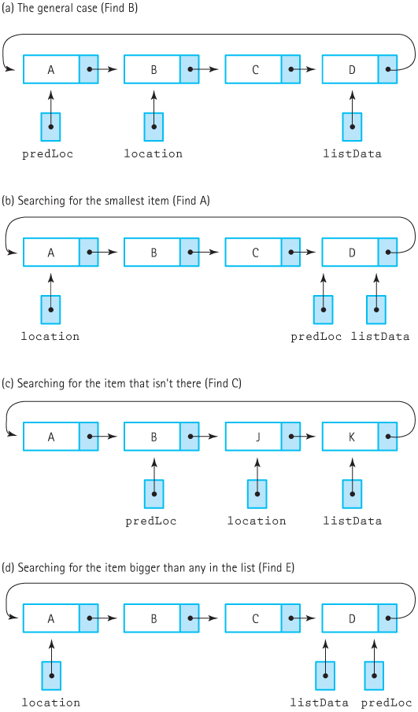
Figure 6.4 The FindItem operation for a circular list (a) The general case (Find B); (b) Searching for the smallest item (Find A); (c) Searching for the item that isn't there (Find C); (d) Searching for the item bigger than any in the list (Find E)

Slide 14
Circular Linked List: Inserting Items
General case: Link predecessor to new node and new node to successor
Inserting into an empty list: The new node points to itself
Inserting into the front of a list: Only special in regular linked lists
Inserting at the end of a list: Update the external pointer

Slide 15
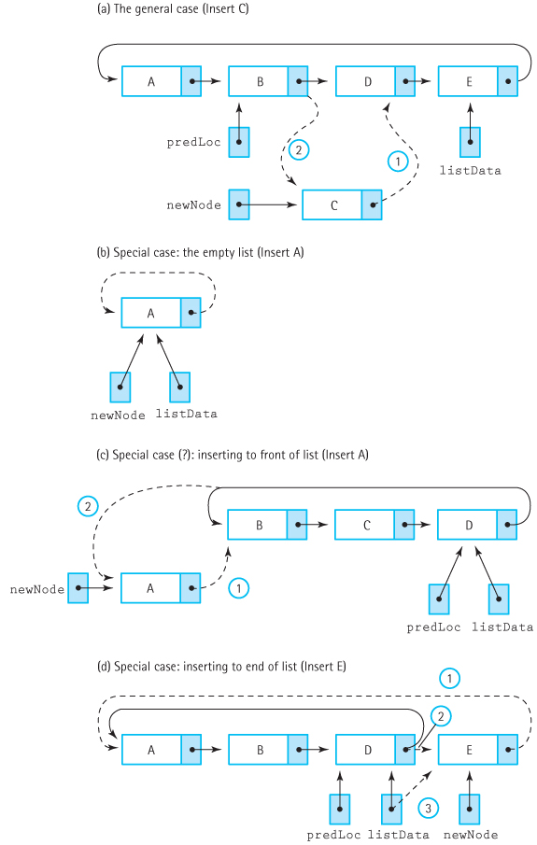
Figure 6.5 Inserting into a circular linked list (a) The general case (Insert C); (b) Special case: the empty list (Insert A); (c) Special case (?): inserting to front of list (Insert A); (d) Special case: inserting to end of list (Insert E)

Slide 16
Circular Linked List: Deleting Items
General case: Update predecessor to point to deleted item’s successor, then delete item
Deleting only item in list: Set external pointer to NULL
Deleting item at the end of a list: Update external pointer to point to deleted node’s predecessor

Slide 17
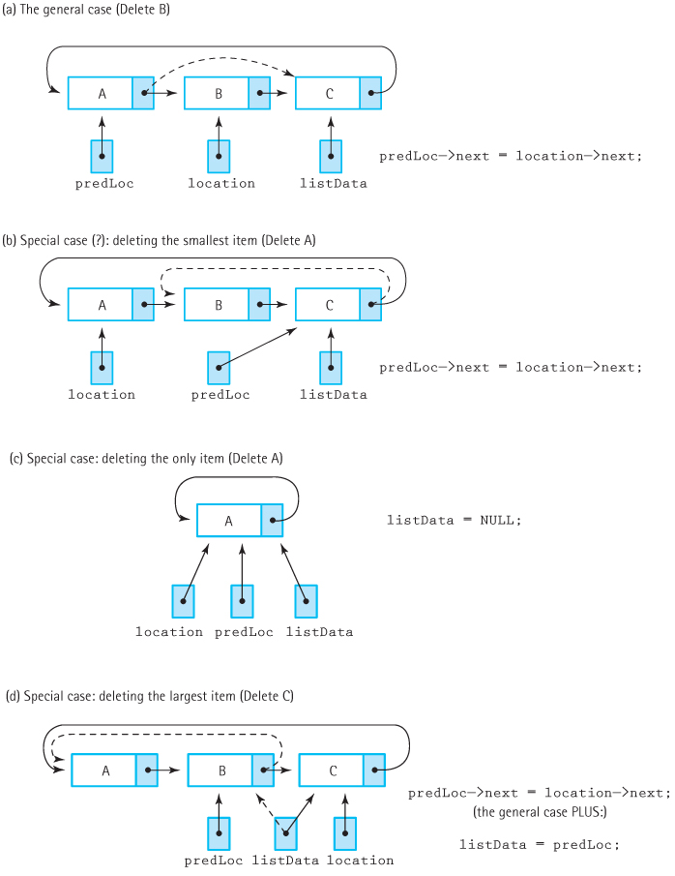
Figure 6.6 Deleting from a circular linked list (a) The general case (Delete B) (b) Special case (?): deleting the smallest item (Delete A) (c) Special case: deleting the only item (Delete A) (d) Special case: deleting the largest

Slide 18
Doubly Linked List
A linked list in which every node has 2 pointers, linking it to its successor and predecessor
First node has NULL predecessor pointer
Last node has NULL successor pointer
Can walk forward or backward through the list
Figure 6.7 A linear doubly linked list

Slide 19
Doubly Linked List: Finding Items
“Inchworm” search no longer needed, since the previous element can be accessed directly
FindItem only needs to return the pointer to the item or the item’s successor

Slide 20
Doubly Linked List Operations
Insertion and deletion are slightly more complex due to the additional pointers
Both the predecessor and the successor of the target node must have their pointers updated
Operating on items at either end of the list is similar to singly linked lists

Slide 21
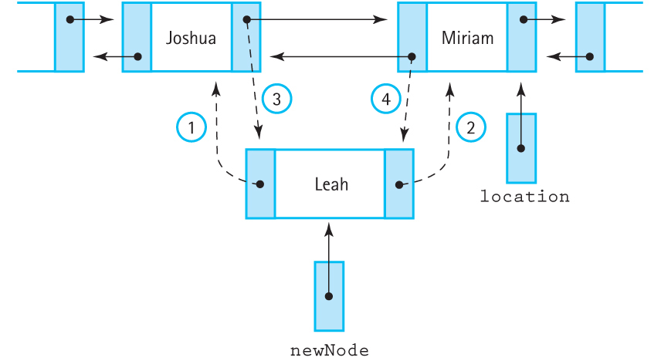
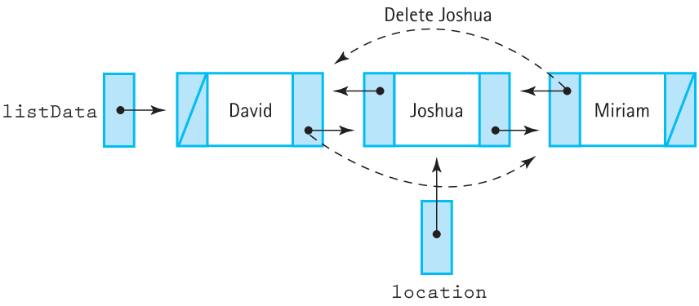
Doubly Linked List Operations (cont.)
Figure 6.9 Linking the new node into the list
Figure 6.10 Deleting from a doubly linked list

Slide 22
Lists with Headers and Trailers
Insertion and deletion can be simplified if they never have to choice the first and last nodes
This can be accomplished using dummy nodes whose values are outside the expected range
Header node: A placeholder at the beginning of a list
Trailer node: A placeholder at the end of a list

Slide 23
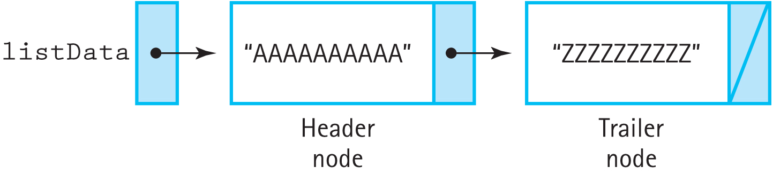
Lists with Headers and Trailers (cont.)
For example, a list of students probably won’t have students named “AAAAA” and “ZZZZZ”
Could also use blank nodes and always skip processing those nodes
Figure 6.11 An “empty” list with a header and a trailer

Slide 24
Copying Structures
What would happen if we tried to create a copy of a stack?
Can’t just pop off elements and push them into a new stack, since that could destroy the original stack
We could try to recreate the stack, but it wouldn’t be sent back to the caller
Solution: Use a copy constructor

Slide 25
Shallow and Deep Copying
Shallow copy: An operation that copies a class object without copying any pointed-to data
Deep copy: An operation that copies a class object and any additional data it points to
C++ uses shallow copying by default when passing objects by value, returning an object from a function, and for the assignment operator (e.g., stack1 = stack2;)

Slide 26
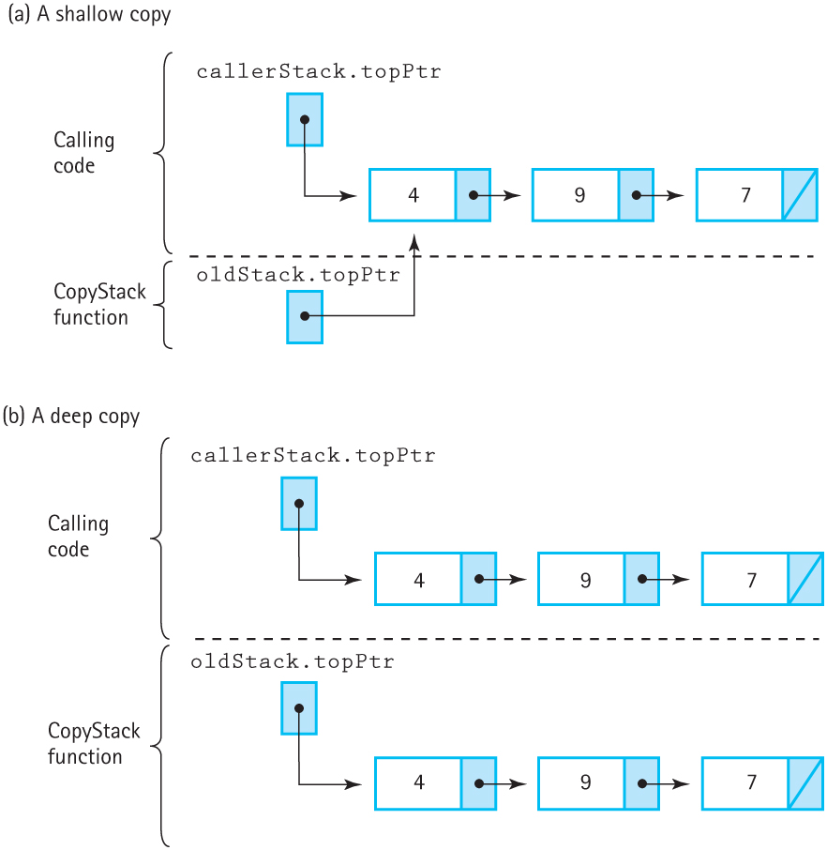
Shallow and Deep Copying (cont.)
Figure 6.13 Shallow copy versus deep copy of a stack (a) A shallow copy
(b) A deep copy

Slide 27
Copy Constructors
Copy constructor: A constructor that is invoked when a copy of a class is created, such as when an object is passed by value, returned from a function or initialized in a declaration
Assignment is a special case that requires other methods to override
A copy constructor looks like a regular constructor but takes an object of the same type as a reference parameter

Slide 28
Copying in Assignment
There are two approaches for allowing copying in an assignment statement, such as stack1 = stack2
One is to write a member function that will handle the copying instead of using assignment
The other is to overload the assignment operator

Slide 29
Copy Function
Example: stack1.CopyStack(stack2)
Should this copy stack2 into stack1, or stack1 into stack2? The syntax is ambiguous
Another option is: CopyStack(stack1, stack2)
Can clearly say or stack1 is copied into stack2
This can be accomplished using a friend function

Slide 30
C++ Friend Functions
Friend function: A function that is not a member of a class but has direct access to all of the private members of a class
They must be declared within a class definition:
friend void Copy(StackType<ItemType>, StackType<ItemType>&);
Copy has no implicit self like member functions do, and must access private members using the parameters

Slide 31
Operator Overloading
It would be nice if myStack = yourStack created a deep copy instead of a shallow copy
C++ allows classes to overload operators such as “=” using member functions:
Definition: void operator=(StackType<ItemType>);
Operators can be overloaded with different parameters as many times as needed
Some operators can’t be overloaded: ::, sizeof, ., and ?:

Slide 32
Operator Overloading Examples
Operator=: Used for deep copying; should behave the same as a Copy(dest, source) function
Operator< and Operator>: Relational operators; should not modify either argument
Operator==: Check if two objects are equal

Slide 33
Operator Overloading Guidelines
At least one operand of the overloaded operator must be a class instance
You cannot change the order of operators, define new operators, or change the number of operands of an operator
In some situations, it is clearer to implement the overloading function as a friend function instead of a member function

Slide 34
Operator Overloading Guidelines (cont.)
Overloading ++ and -- requires client code to use the prefix form: ++someObject
Operator functions must be member functions when overloading =, (), <> and ->
Think very carefully when overloading (), <> and ->
The stream operators << and >> must be overloaded using a friend function
The compiler must be able to distinguish between the data types of the operands

Slide 35
Linked List as an Array of Records
“Array vs. Linked List” is not the same as “static vs. dynamic allocation”
Dynamically allocated arrays, for example
But what about statically allocated linked lists?
It’s possible to implement a linked list using an array with the indices acting as links

Slide 36
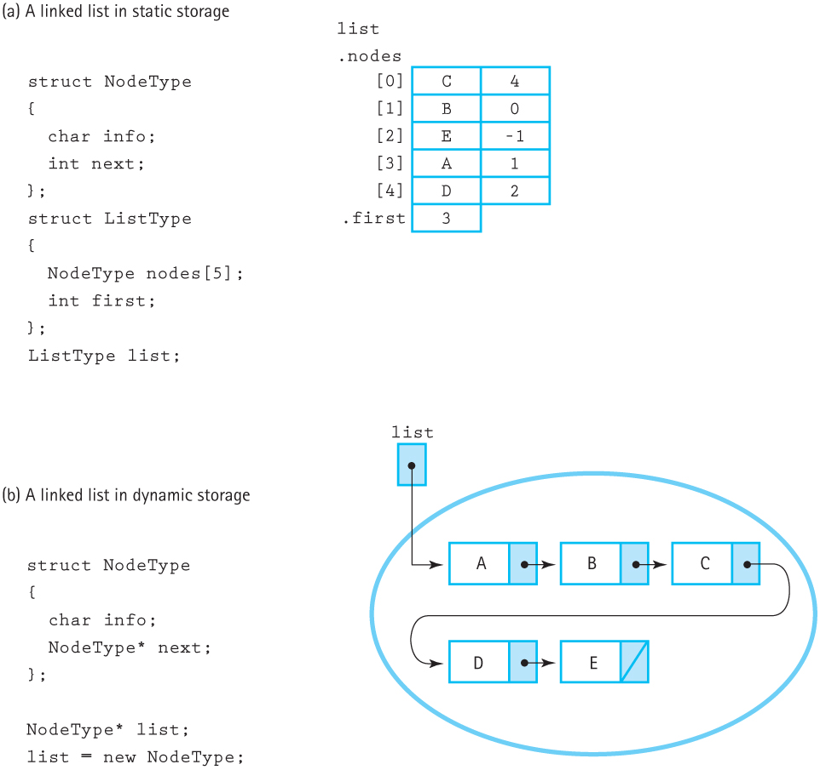
Linked List as an Array of Records (cont.)
Figure 6.16 Linked lists in static and dynamic storage (a) A linked list in static storage (b) A linked list in dynamic storage

Slide 37
Why Use an Array?
All the advantages of linked lists without needing to allocate memory or use pointers
Some languages or systems don’t support these features
The overhead can be too high for some applications
Easier to store an array-based list between runs of the program

Slide 38
How Is an Array Used?
Each node in the array holds data and contains the index of the next node in the list
The last node uses -1 (“NUL”) instead of NULL
The array contains nodes (data + index) and free space (no data)
Inserting an item uses a free space, and deleting an item frees up a space
The free space is handled as a list

Slide 39
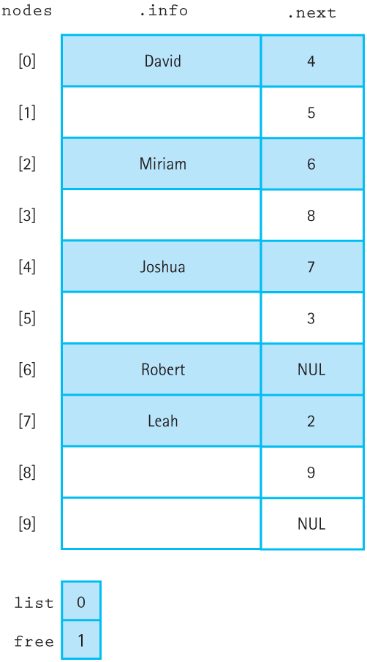
Sorted List in an Array of Records
Note that in both there are two lists: the store data and the free space
Figure 6.18 An array with a linked list of values and free space

Slide 40
Array of Records Operations
Array of records uses three bookkeeping functions
InitializeMemory: All nodes are added to the free list and linked together
GetNode: Return the index of the first free node and update the free list pointer
FreeNode: Return a node to the free list
The array itself is stored in a struct along with the index of the free list

Slide 41
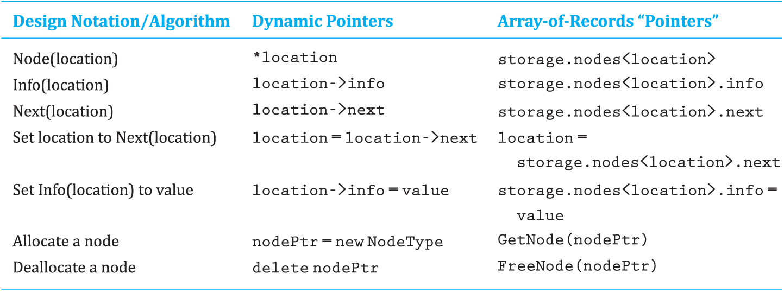
Array of Records vs. Linked List
The array of records indices and the linked list pointers can be used the same ways:

Slide 42
Array as Dynamic Memory
A single array is used as a “heap” with multiple lists allocating nodes in the array
Each list allocates nodes from the free list, similar to how dynamic memory works
Multiple external pointers point to the lists inside the array

Slide 43
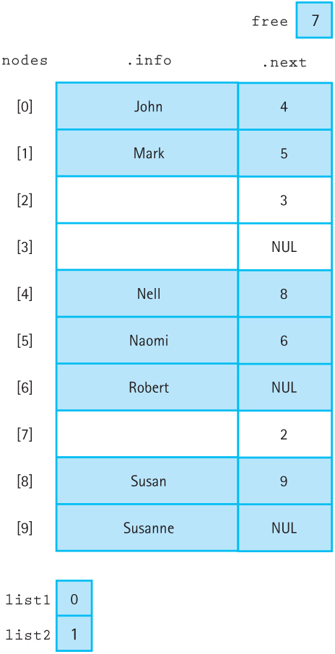
Array as Dynamic Memory (cont.)
Figure 6.19 An array with three lists (including the free list)

Slide 44
Polymorphism with Virtual Functions
Polymorphism: The ability to determine which function to apply to an object; one of the three fundamentals of object-oriented programming
Dynamic binding: The function is chosen at run time, based on the type and number of arguments

Slide 45
Polymorphism with Virtual Functions (cont.)
C++ forces formal parameters and actual parameters to have the same type
Inheritance relaxes this: the actual parameter’s class can be a subclass of the formal parameter
Consider the line: formalParam.MemberFunc();
If the actual parameter could be any subclass of the formal parameter, which version of the member function is invoked?

Slide 46
Virtual Member Functions
formalParam.MemberFunc();
If MemberFunc is not virtual, the formal parameter’s version is called
If MemberFunc is virtual, the actual parameter’s version is called

Slide 47
Polymorphism and Parameters
When will the derived class’s methods be used?
The actual parameter is passed as a reference
The actual parameter is a pointer defined as a pointer to the base class and points to an object of the derived class
Passing a derived class by value makes only the subobject of the base class available in the function

Slide 48
Polymorphism Example
#include <iostream>
class One {
public:
virtual void Print() const;
};
class Two : public One {
public:
void Print() const;
};
void One::Print() const {
std::cout << "Print class One" << std::endl;
}
void Two::Print() const {
std::cout << "Print class Two " << std::endl;
}

Slide 49
Polymorphism Example (cont.)
// Takes a base-class object by reference
void PrintRef(One& ptr) {
ptr.Print();
}
// Takes a pointer to a base-class object
void PrintPtr(One* ptr) {
ptr->Print();
}
// Takes a base-class object by value
void PrintVal(One ptr) {
ptr.Print();
}

Slide 50
Polymorphism Example (cont.)
int main() {
using namespace std;
One one;
Two two;
cout << "Result of printing one:" << endl;
PrintRef(one); // Output: “Print class One”
PrintPtr(&one); // Output: “Print class One”
PrintVal(one); // Output: “Print class One”
cout << "Result of printing two:" << endl;
PrintRef(two); // Output: “Print class Two”
PrintPtr(&two); // Output: “Print class Two”
PrintVal(two); // Output: “Print class One”
cout << "Pointer to a derived type:" << endl;
One *onePtr = new One;
PrintPtr(onePtr); // Output: “Print class One”
onePtr = new Two;
PrintPtr(onePtr); // Output: “Print class Two”
return 0;
}

Slide 51
A Specialized List ADT
The earlier list ADTs have some restrictions:
List elements must be unique – no duplicates!
Clients can only iterate forward (from beginning to end) through the list
For some applications, this is not enough
Case study: A list of integers that supports duplicate elements, bidirectional iteration, and inserting elements at either end of the list

Slide 52
A Specialized List ADT (cont.)
Which structure is best for this?
Double linked allows iteration in both directions, except it doesn’t give access to the last element, which is where reverse iteration begins
A circular linked list does provide access to the last element, making inserting at either end easier, but only supports iteration in one direction
Both support duplicate elements
Combine them: doubly linked circular list

Slide 53
List Operations
Don’t need IsFull, GetItem, or DeleteItem
PutFront and PutEnd: Insert items at desired end of the list
GetLength: Return number of items in the list
ResetForward and ResetBackward: Reset iteration for the desired direction
GetNextItem and GetPriorItem: Advance iteration of the desired direction

Slide 54
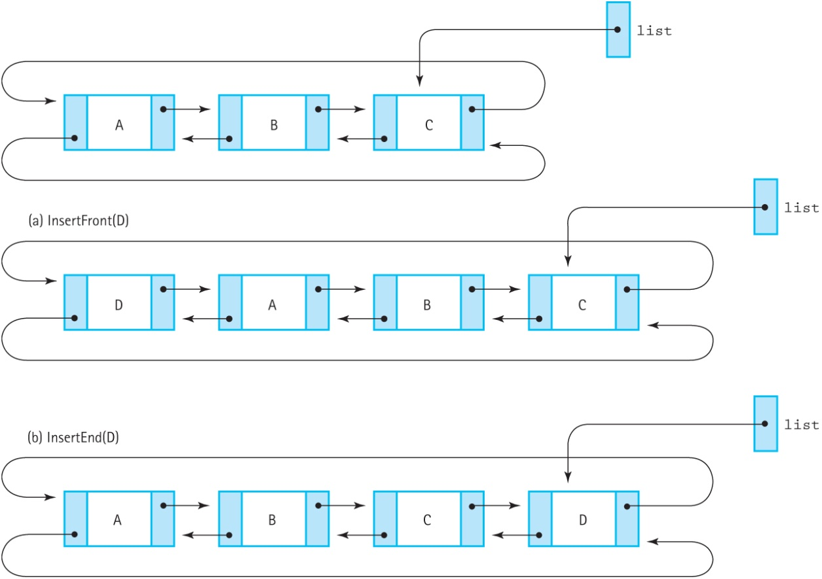
Inserting Items
PutEnd is the same as PutFront, except the external pointer is updated.
Figure 6.22 Putting at the front and at the rear (a) InsertFront(D) (b) InsertEnd(D)

Slide 55
List Iterations
Allow simultaneous iteration in both directions
Keep track of iteration position going forward and going backward using two fields
Calling a forward iteration method (ResetForward or GetNextItem) has no effect on the backward iteration methods (ResetBackward and GetPriorItem) and vice versa

Slide 56
Range-Based Iteration
Basic C++ for loop:
for (j = 0; j < length; j++)
Several possible errors: initialize j to the wrong value (j = 0 or j = 1?), or wrong terminating condition (j < length or j <= length?)
Tight control over the index j, such as allowing j += 2 instead of just j++

Slide 57
Ranged-Based Iteration (cont.)
Ranged-based C++ for loop:
for (ElementType e : list)
Abstracts away the iteration index, eliminating common errors
Only allows processing list in order
Actually just syntactic sugar for the regular for loop
Syntactic Sugar: An alternative form or syntax that makes programs easier to read or write

Slide 58
C++ Iterators
Iterator: A class that implements iteration over a particular ADT; must overload dereference (*), increment (++), and inequality (!=)
The ADT provides begin() and end() methods that return iterators representing the beginning and end of the collection
The range-based for loop unfolds into a for loop that uses these tools

Slide 59
C++ Iterators (cont.)
// a list of numbers to process
list<int> numbers(1,2,3,4);
for (int e : numbers) {process(i);}
// The loop is compiled into
// something like:
for (iterator it = numbers.begin();
it != numbers.end(); ++it)
{process(i);}

Slide 60
Implementing Iterators
Iterators are named after the ADT they iterate over, e.g., SortedTypeIterator for the SortedType list implementation
They implement the following operators:
Dereference: Returns the current element of the list
Increment: Advances the iterator forward one step
Inequality: Compares two iterators (e.g., checking if the iterator has reached the end of the list)

Slide 61
SortedListIterator
Encapsulates a pointer into the list as a NodeType<T>* item
Dereference: Returns item->info
Increment: Updates item = item->next, or sets item to NULL if it’s the end of the list
Inequality: Checks if both iterators point to the same item

